Slide 1


Satjeet Singh
August 30th 2022

Slide 2

Outline
Executive Summary
Introduction
Methodology
Results
Conclusion
Appendix

Slide 3
Executive Summary
Summary of methodologies
We used the following methodologies in our project:
Data Collection
Data Wrangling
Data Visualization
SQL
Interactive map with Folium
Dashboard with Plotly Dash
Classification
Summary of all results
We summarized the results with the following:
EDA Results
Interactive analytics
Predictive analysis

Slide 4
Introduction
Now that the commercial space age is here, many companies are endeavoring to make space travel more affordable.
One of these company’s is SpaceX. SpaceX advertises Falcon 9 rocket launches on its website with a cost of 62
million dollars, while other providers cost upwards of 165 million dollars each. Much of SpaceX’s savings is
because they can reuse the first stage.
The task of this project will be to see whether we can accurately predict if the first stage of the SpaceX rocket will land
successfully.

Slide 5


Slide 6
Methodology
Executive Summary
Data collection methodology:
Data was collected in our project by requesting and parsing the SpaceX launch data using a GET request the Space Rest API alongside using Web Scraping techniques to obtain data directly from sites.
Perform data wrangling
After collecting Data, we calculated the number of launches on each site, number and occurrences of orbits, and created a landing outcome label.
Perform exploratory data analysis (EDA) using visualization and SQL
Perform interactive visual analytics using Folium and Plotly Dash
Perform predictive analysis using classification models
We standardized the data and split the data into train and test sets. After testing Logistic Regression, Support Vector machines, Decision Tree Classifier, and K-nearest neighbors, we found the best hyperparameters and calculated the accuracy of the test data.

Slide 7
Data Collection
A get request using the requests library to obtain the launch data will be used to get the data from the SpaceX REST API.
This result is viewed by calling the .json() method and then converted to a data frame, using the json_normalize function.
Another popular data source for obtaining Falcon 9 Launch data is web scraping related
We also used the Python BeautifulSoup package to web scrape HTML tables that contain valuable Falcon 9 launch records. This data was parsed from those tables and converted into Panda’s data frames for further visualization and analysis.
Convert into a data frame by calling the json_normalize method
Use SpaceX REST API
View data by calling .json()method
Get HTML Response
Use pd.DataFrame on the parsed launch record values to create a dataframe.
Extract Data using BeautifulSoup

Slide 8
Data Collection – SpaceX API
1. Use API for a response and convert response to a .jsonfile
spacex_url=https://api.spacexdata.com/v4/launches/past
response = requests.get(spacex_url)
data = pd.json_normalize(response.json())
3. Construct our dataset by combining the columns into a dictionary
launch_dict = {'FlightNumber': list(data['flight_number']),
'Date': list(data['date']),
'BoosterVersion':BoosterVersion,
'PayloadMass':PayloadMass,
‘Orbit':Orbit,
'LaunchSite':LaunchSite,
'Outcome':Outcome,
'Flights':Flights,
'GridFins':GridFins,
'Reused':Reused, 'Legs':Legs,
'LandingPad':LandingPad,
'Block':Block,
'ReusedCount':ReusedCount,
'Serial':Serial,
'Longitude': Longitude,
'Latitude': Latitude}
df = pd.DataFrame.from_dict(launch_dict)
2. Subset our dataframe for keeping relevant features
data = data[['rocket', 'payloads', 'launchpad', 'cores', 'flight_number', 'date_utc']]
4. Filter data and export to .csv
data_falcon9 = df[df['BoosterVersion']!='Falcon 1’]
data_falcon9.to_csv('dataset_part\_1.csv', index=False)
https://github.com/satchiffre/Applied-Data-Science-Capstone/blob/main/Data%20Collection%20API%20Lab%20(1).ipynb

Slide 9
Data Collection - Scraping
1. Request the Falcon9 Launch Wiki page from its URL
static_url = "https://en.wikipedia.org/w/index.php?title=List_of_Falcon_9_and_Falcon_Heavy_launches&oldid=1027686922"
response = requests.get(static_url).text
soup = BeautifulSoup(response, 'html5lib’)
2. Extract all column/variable names from the HTML table header
html_tables = soup.find_all('table’)
column_names = []
for row in first_launch_table.find_all('th’):
name = extract_column_from_header(row)
if (name != None and len(name) > 0):
column_names.append(name)
3. Create a data frame by parsing the launch HTML tables
launch_dict= dict.fromkeys(column_names)
del launch_dict['Date and time ( )’]
list launch_dict['Flight No.'] = []
launch_dict['Launch site'] = []
launch_dict['Payload'] = []
launch_dict['Payload mass'] = []
launch_dict['Orbit'] = []
launch_dict['Customer'] = []
launch_dict['Launch outcome'] = []
launch_dict['Version Booster']=[]
launch_dict['Booster landing']=[]
launch_dict['Date']=[]
launch_dict['Time']=[]
4. After we’ve parsed launch record values into launch_dict, you can create a dataframe from it.
df=pd.DataFrame(launch_dict)
https://github.com/satchiffre/Applied-Data-Science-Capstone/blob/main/Complete%20the%20Data%20Collection%20with%20Web%20Scraping%20lab.ipynb

Slide 10
Data Wrangling
1. Check for null values
2. Calculate the number of launches on each site
3. Calculate the number and occurrences of each orbit
5. Create a landing outcome label
4. Calculate the number and occurrence of mission outcome per orbit type
https://github.com/satchiffre/Applied-Data-Science-Capstone/blob/main/labs-jupyter-spacex-Data%20wrangling.ipynb

Slide 11
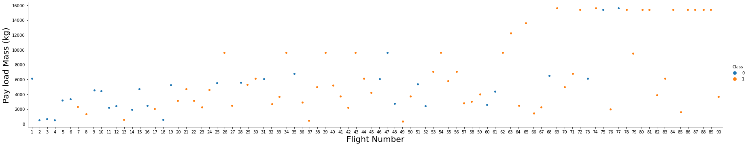
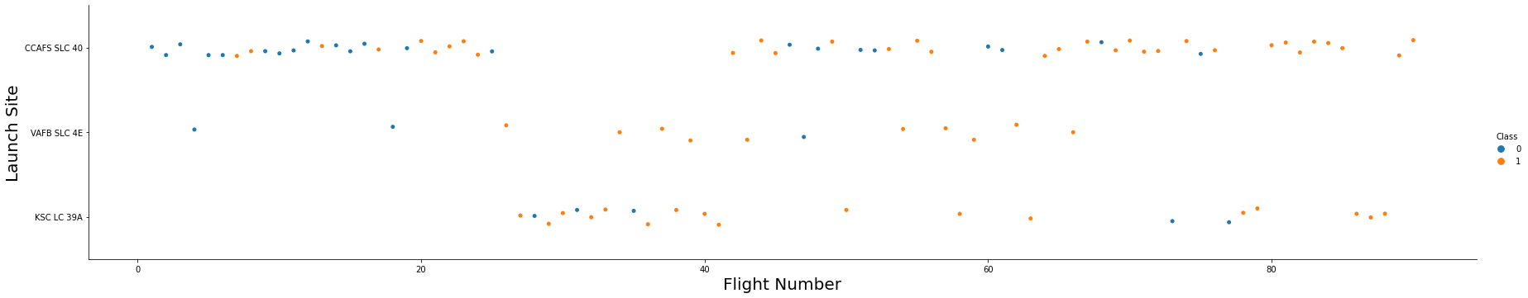
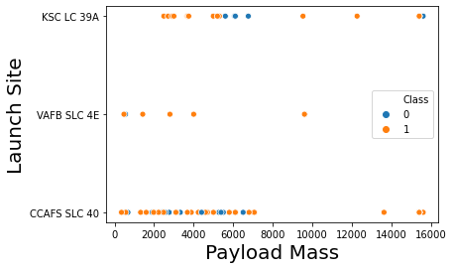
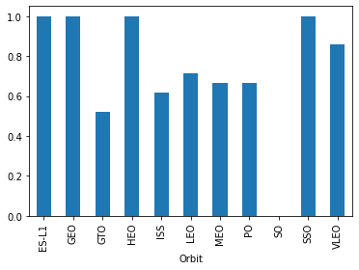
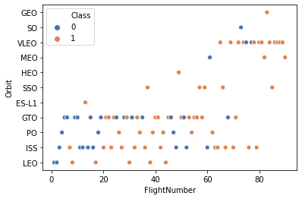
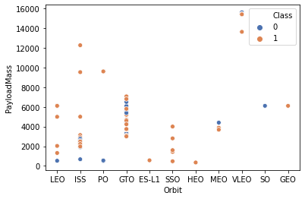
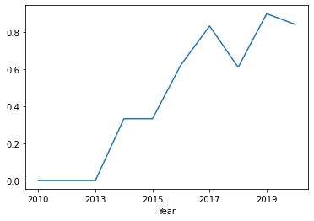
EDA with Data Visualization
We plotted a CatPlot to see how the FlightNumber and Payload variables would affect the launch outcome.
We plotted a CatPlot to Visualize the relationship between Flight Number and Launch Site.
We plotted a Scatter Plot to Visualize the relationship between Payload and Launch Site
We created a bar chart for the success rate of each orbit
We plotted a Scatter Plot to Visualize the relationship between FlightNumber and Orbit type
We plotted a Scatter Plot to Visualize the relationship between Payload and Orbit type
We plot a line chart with x axis to be Year and y axis to be average success rate, to get the average launch success trend.
https://github.com/satchiffre/Applied-Data-Science-Capstone/blob/main/jupyter-labs-eda-dataviz.ipynb

Slide 12
EDA with SQL
SQL queries performed:
Display the names of the unique launch sites in the space mission
Display 5 records where launch sites begin with the string 'CCA'
Display the total payload mass carried by boosters launched by NASA (CRS)
Display average payload mass carried by booster version F9 v1.1
List the date when the first succesful landing outcome in ground pad was acheived.
List the names of the boosters which have success in drone ship and have payload mass greater than 4000 but less than 6000
List the total number of successful and failure mission outcomes
List the names of the booster_versions which have carried the maximum payload mass. Using a subquery.
List the records which will display the month names, failure landing_outcomes in drone ship ,booster versions, launch_site for the months in year 2015.
Rank the count of successful landing_outcomes between the date 04-06-2010 and 20-03-2017 in descending order.
https://github.com/satchiffre/Applied-Data-Science-Capstone/blob/main/jupyter-labs-eda-sql-coursera_sqllite%20(1).ipynb

Slide 13
Build an Interactive Map with Folium
We marked all launch sites on a map by first creating a folium Map object, and then used folium.Circle to add a highlighted circle area on a specific coordinate. Afterwards we created and added folium.Circle and folium.Marker for each launch site on the site map.
We marked the success/failed launches for each site on the map by creating a MarkerCluster object. For each launch result we add a folium.Marker to marker_cluster.
To calculate the distances between a launch site to its proximities we add a MousePosition on the map to obtain the coordinates over a point on the map.
https://github.com/satchiffre/Applied-Data-Science-Capstone/blob/main/lab_jupyter_launch_site_location.ipynb

Slide 14
Build a Dashboard with Plotly Dash
We created a Dashboard with Plotly Dash to display various charts.
We added a pie chart to show the total successful launches count for all sites, this chart allows us to select a payload range to see how the change in payload range affects the success rate.
We added a scatter chart to show the correlation between payload and launch success.
https://github.com/satchiffre/Applied-Data-Science-Capstone/blob/main/spacex_dash_app.py

Slide 15
Predictive Analysis (Classification)
We standardized the data and split the data into train and test sets.
After testing Logistic Regression, Support Vector machines, Decision Tree Classifier, and K-nearest neighbors,
we found the best hyperparameters and calculated the accuracy of the test data.
We applied the above steps to create all the above list models.
Standardize the data in X then reassign it to the variable X using the transform provided below.
Use the function train_test_split to split the data X and Y into training and test data
Create a classification object then create a GridSearchCV object logreg_cv with cv = 10.
Calculate the accuracy on the test data using the method score & take a look at the confusion matrix
https://github.com/satchiffre/Applied-Data-Science-Capstone/blob/main/SpaceX_Machine%20Learning%20Prediction_Part_5.ipynb

Slide 16
Results
Exploratory data analysis results – The overall success rate was 67%.
Interactive analytics demo in screenshots.
Predictive analysis results:
KNN – 83%
SVM – 83%
LR – 83%
TREE – 83%

Slide 17

Section 2

Slide 18
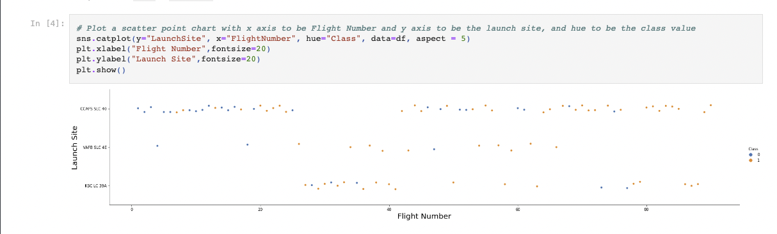
Flight Number vs. Launch Site

Slide 19
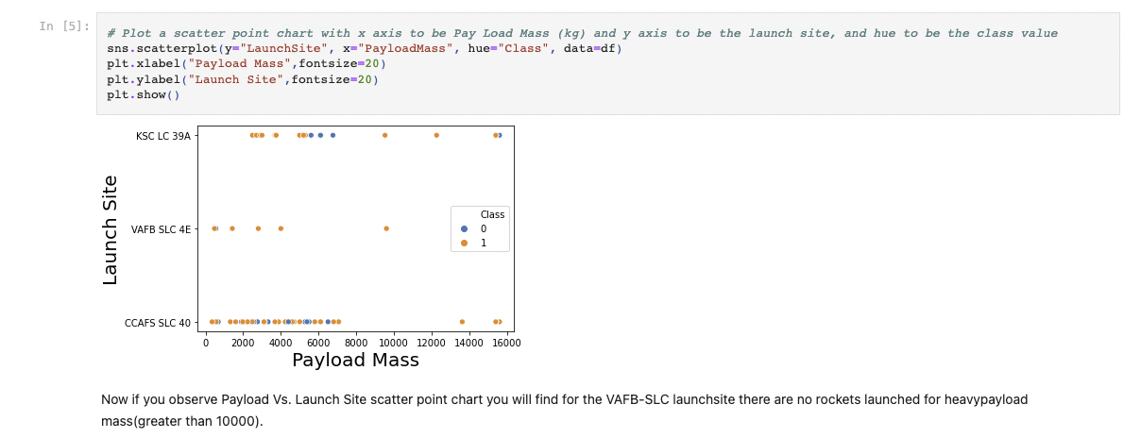
Payload vs. Launch Site

Slide 20
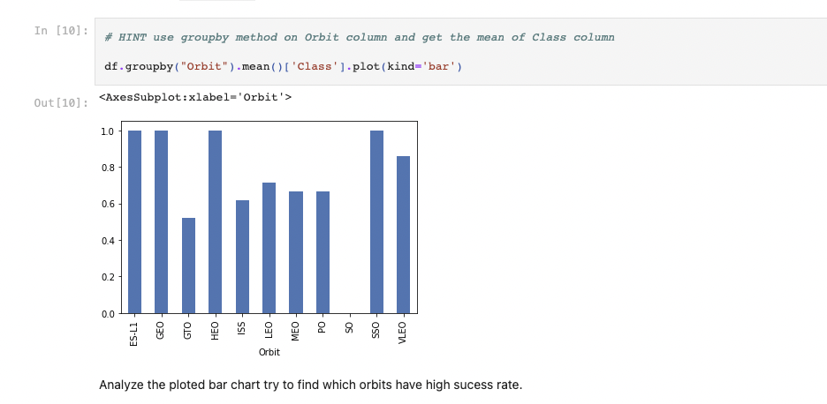
Success Rate vs. Orbit Type

Slide 21
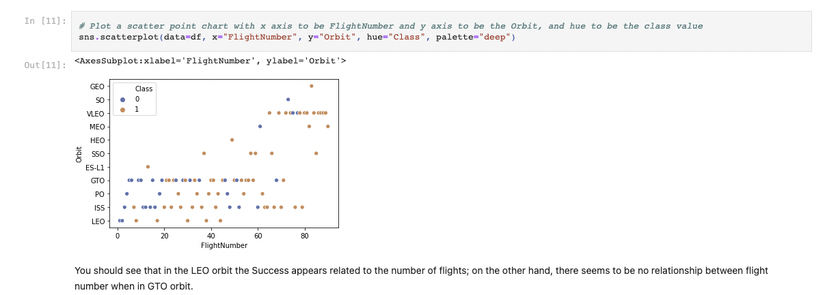
Flight Number vs. Orbit Type

Slide 22
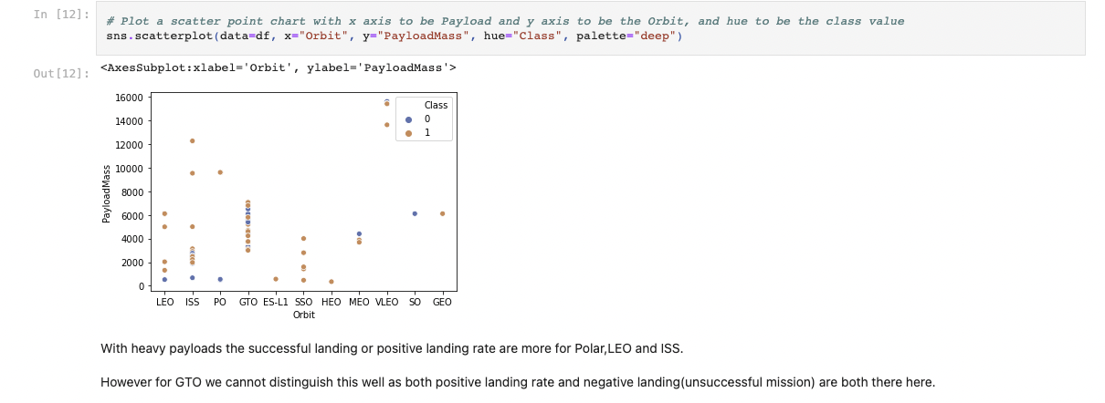
Payload vs. Orbit Type

Slide 23
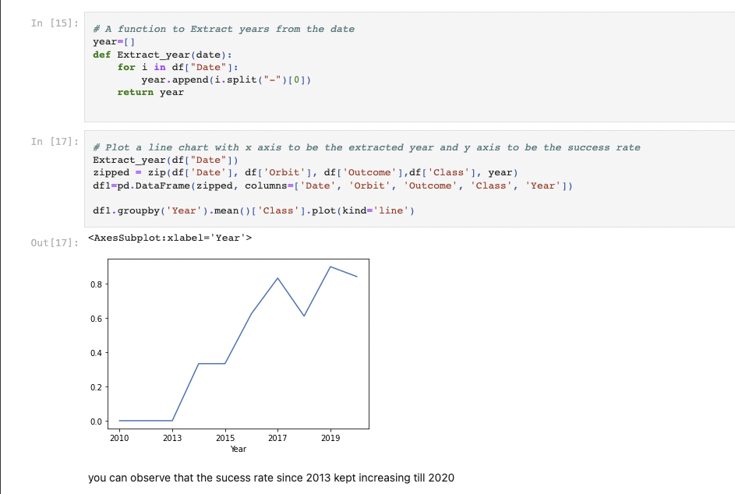
Launch Success Yearly Trend

Slide 24
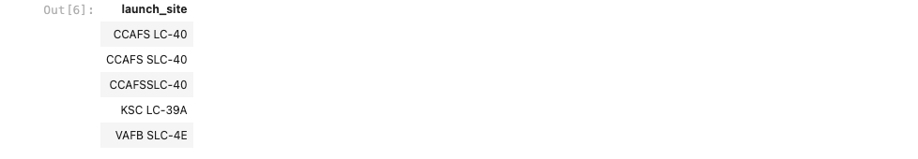
All Launch Site Names
The above query will display all the launch site names.

Slide 25
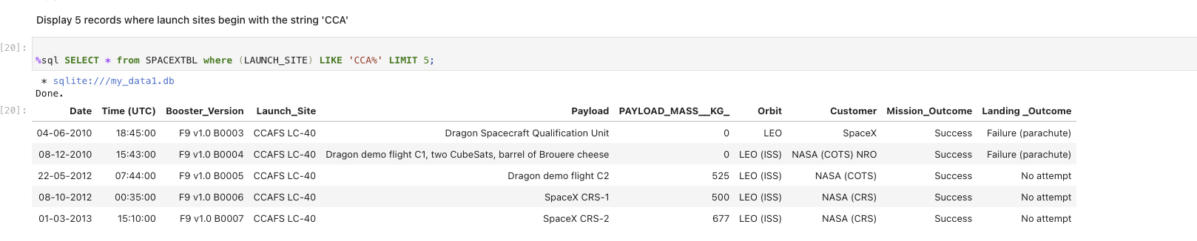
Launch Site Names Begin with 'CCA'
The above query will display 5 records where launch sites begin with the string CCA.

Slide 26
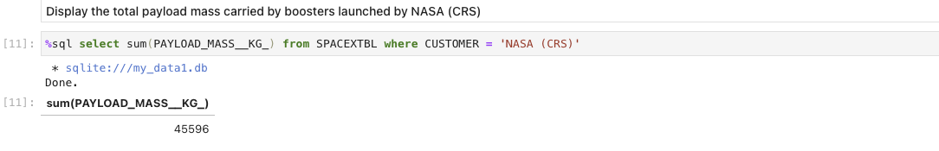
Total Payload Mass
We used the SUM formula to calculate the total and used the WHERE clause to specify NASA.

Slide 27
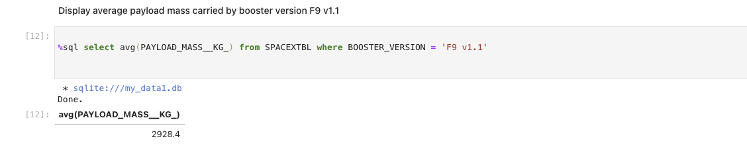
Average Payload Mass by F9 v1.1
We used the AVG formula to calculate the average and used the WHERE clause to specify the booster version.

Slide 28


First Successful Ground Landing Date
We used the min function to get the earliest date of a successful landing outcome in ground pad.

Slide 29
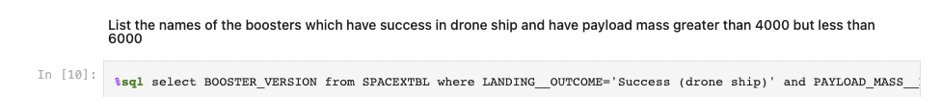

Successful Drone Ship Landing with Payload between 4000 and 6000
We used a WHERE clause with AND to specify for multiple conditions.

Slide 30

Total Number of Successful and Failure Mission Outcomes
By using group by and count we were able to group by mission outcome and get a total for each outcome.

Slide 31
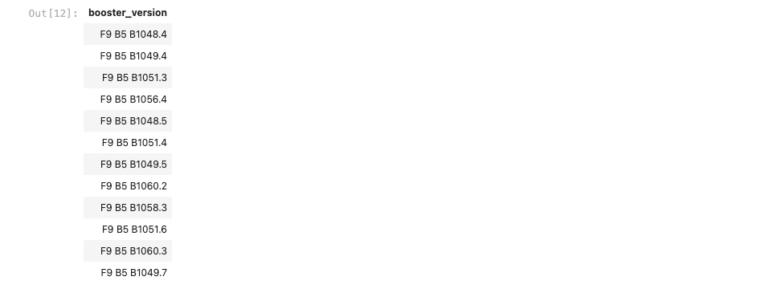
Boosters Carried Maximum Payload
We used a subquery to calculate what the MAX Payload is and then were able to specify the BOOSTER_VERSIONs with our WHERE clause.

Slide 32
2015 Launch Records
We used multiple clauses along with ORDER BY to get the dates in order in 2015.

Slide 33
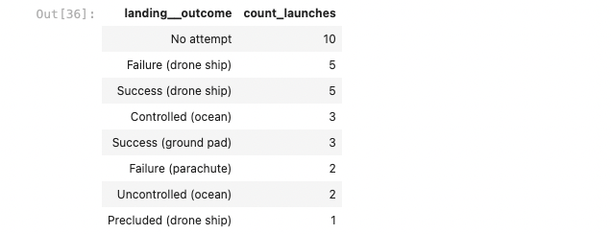
Rank Landing Outcomes Between 2010-06-04 and 2017-03-20
We used between in our WHERE clause to specify the time period.

Slide 34

Section 3

Slide 35
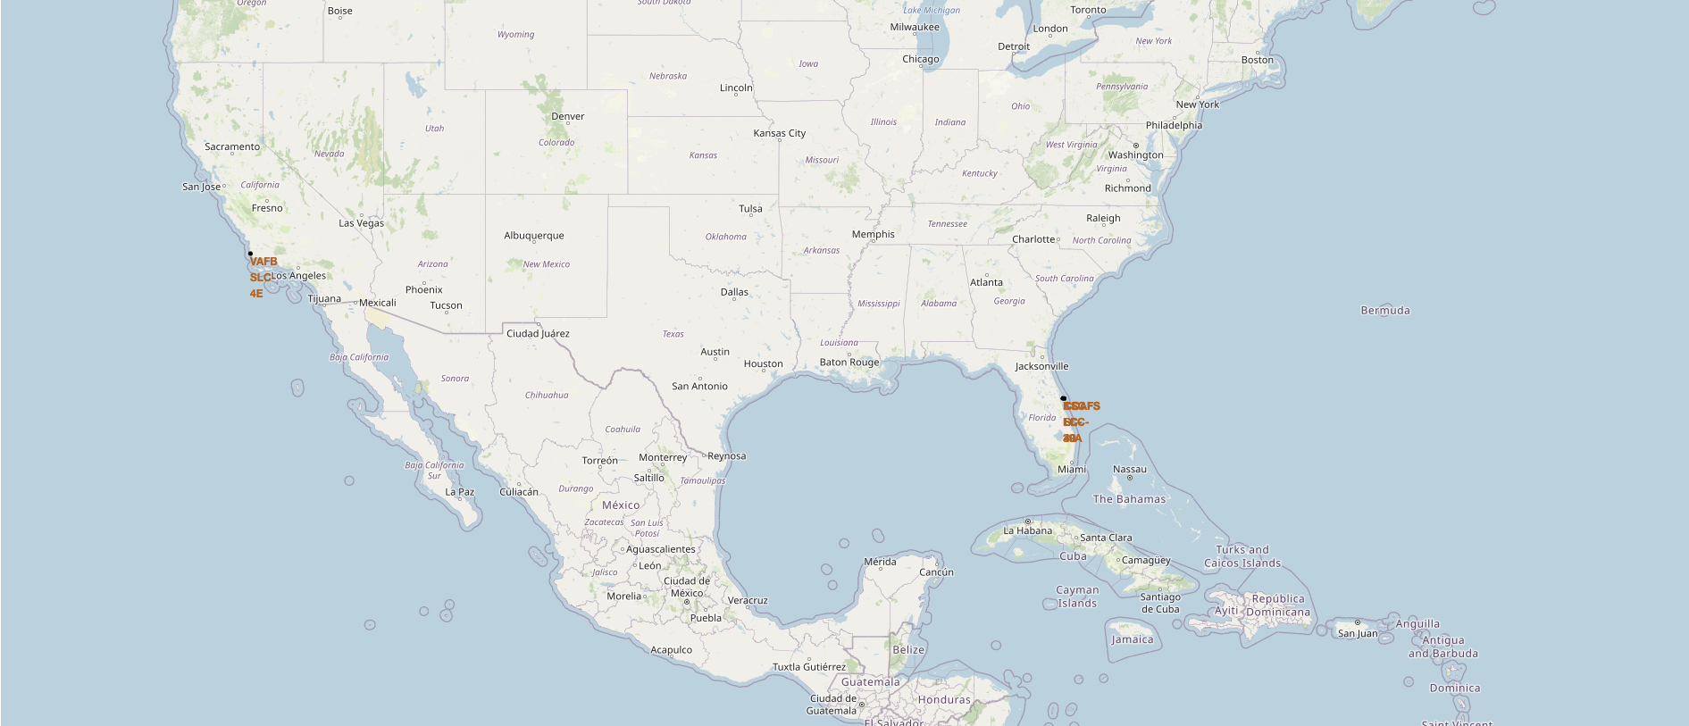
All launch sites’ location markers
The map shows all the location markers on the US map. All locations are located on coasts of the country.

Slide 36
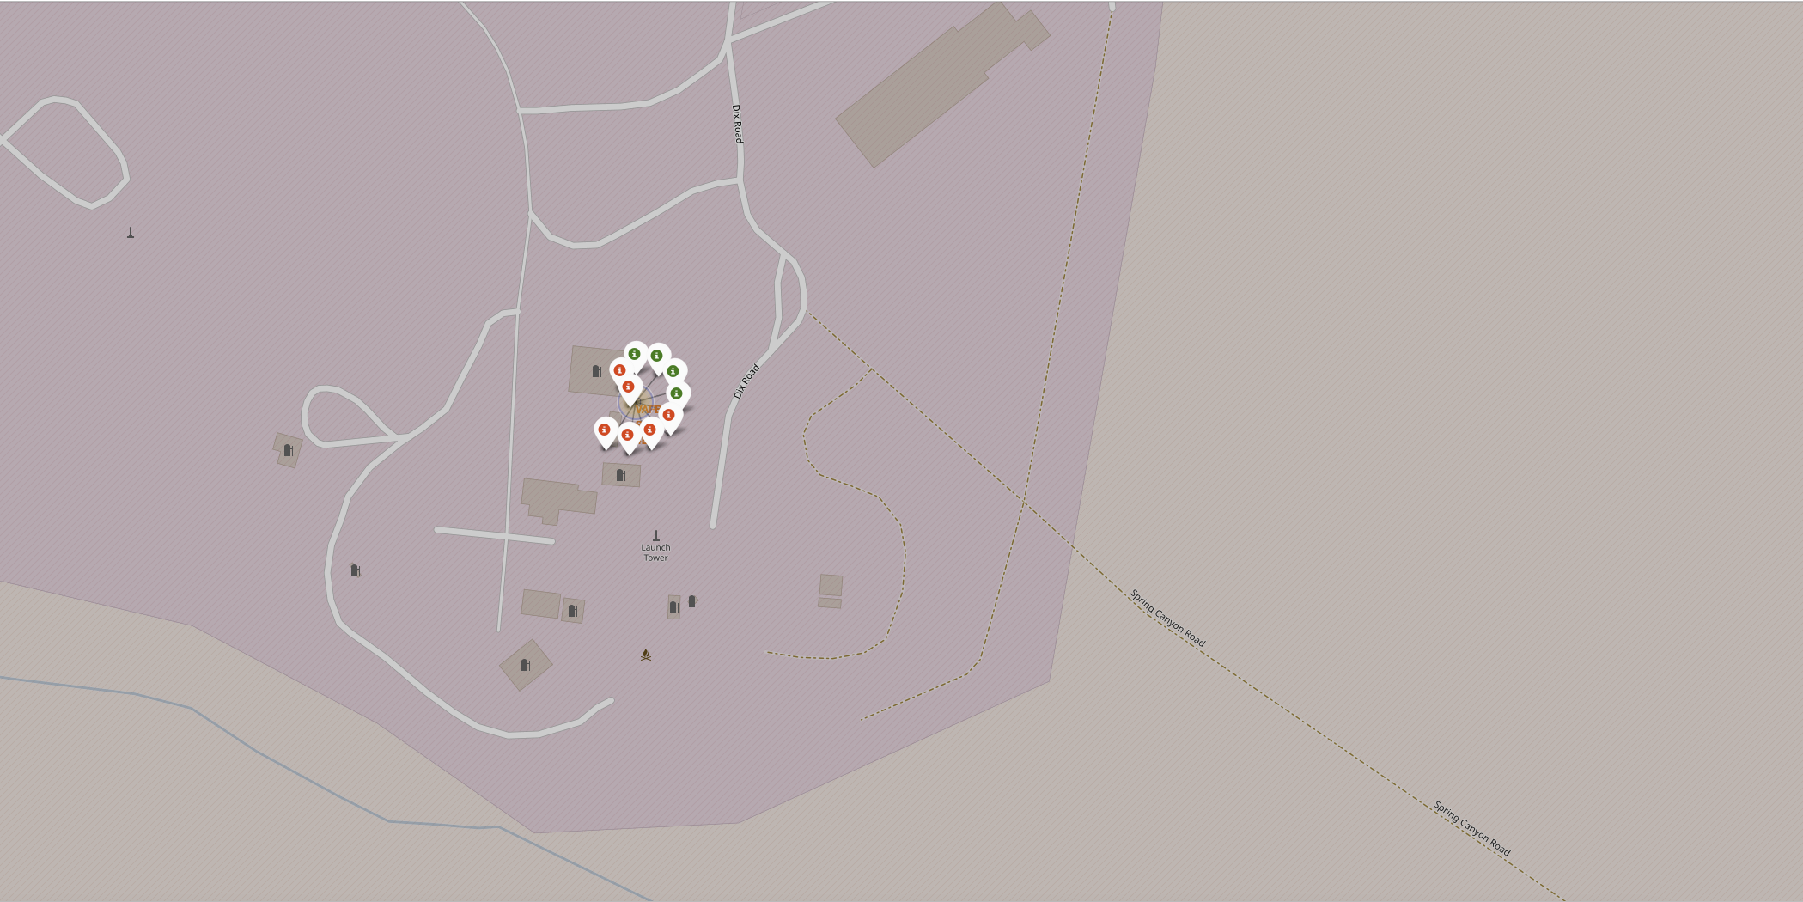
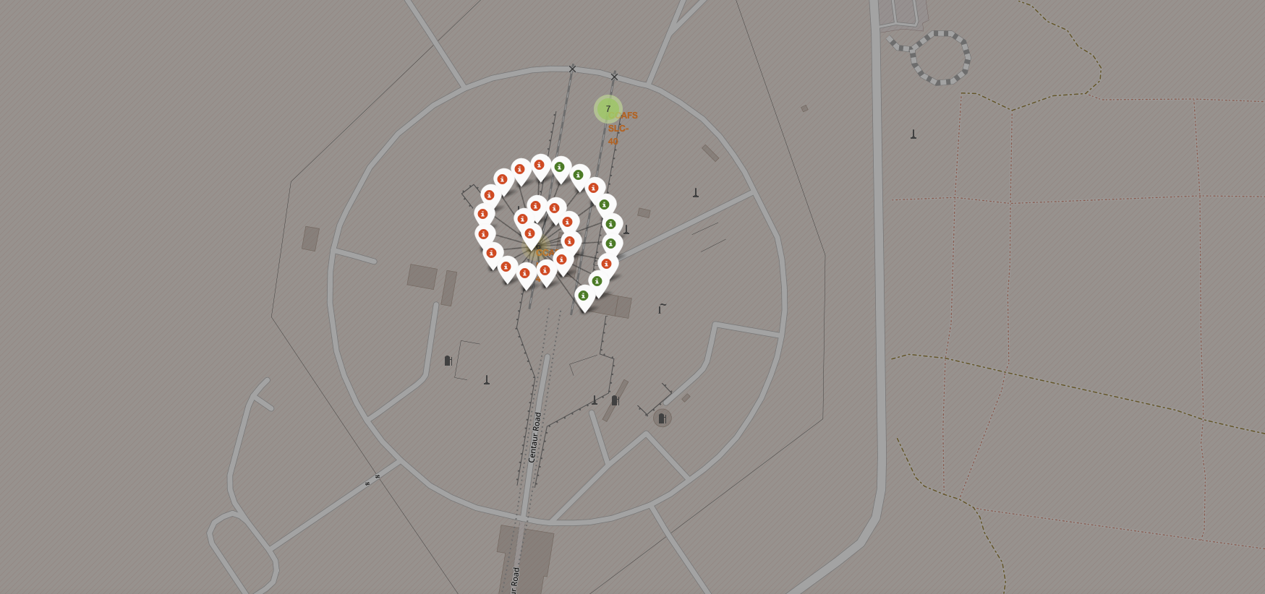
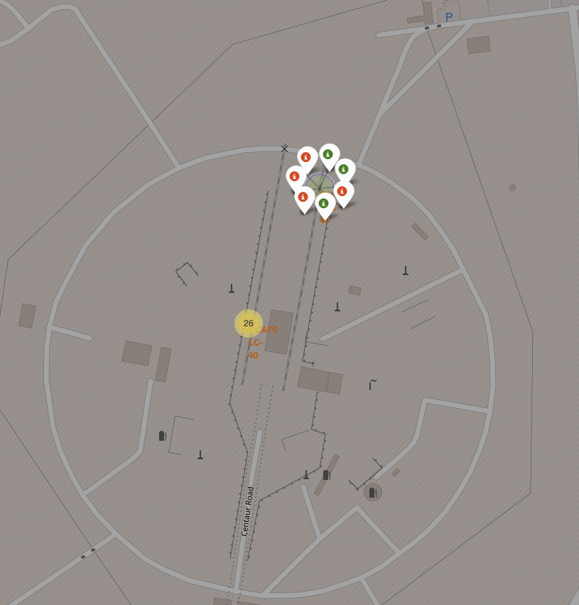
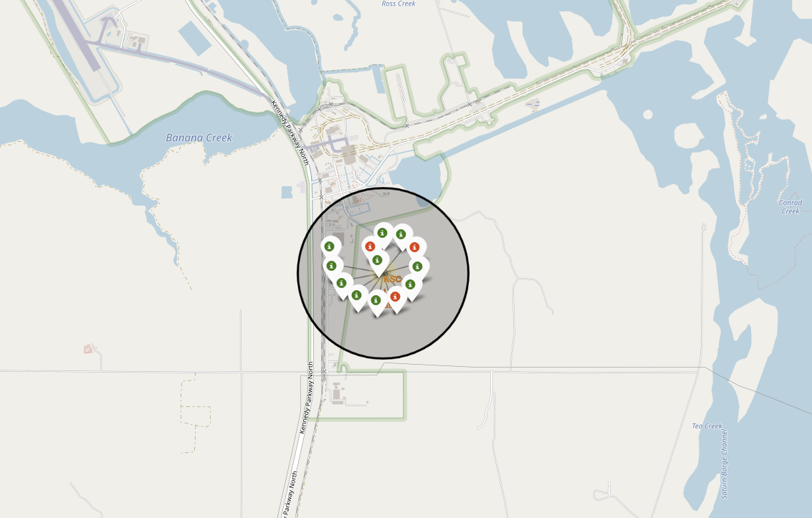
Color-labeled launch outcomes on the map
The folium maps show the outcomes for each launch site.

Slide 37
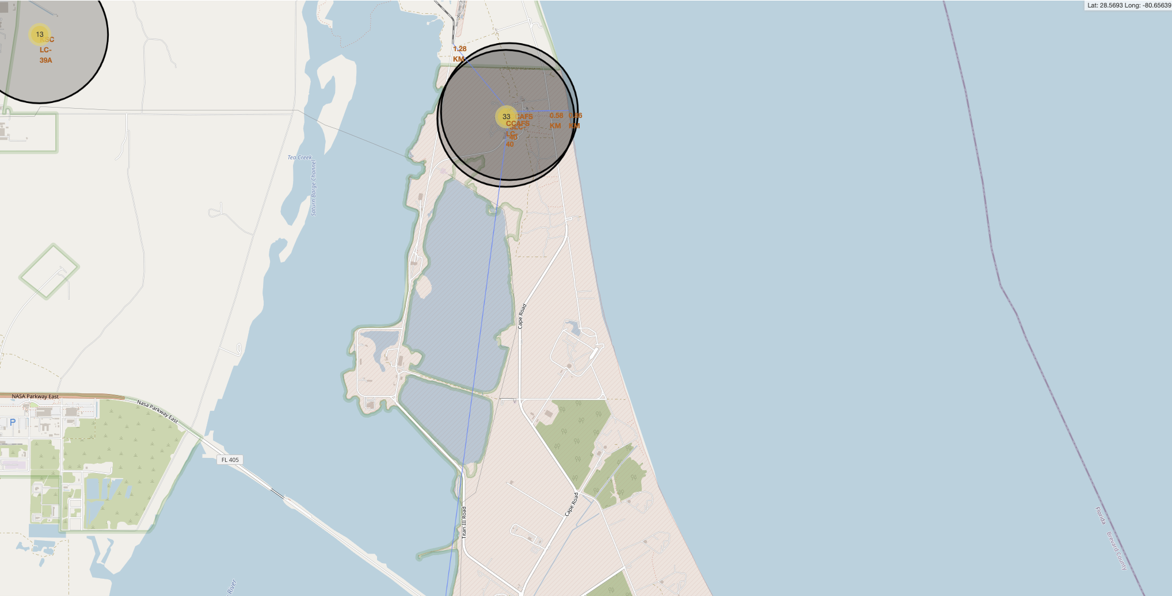
Launch site with distance
The map shows the distance from the launch sites to the coast and the distance between.

Slide 38

Section 4

Slide 39
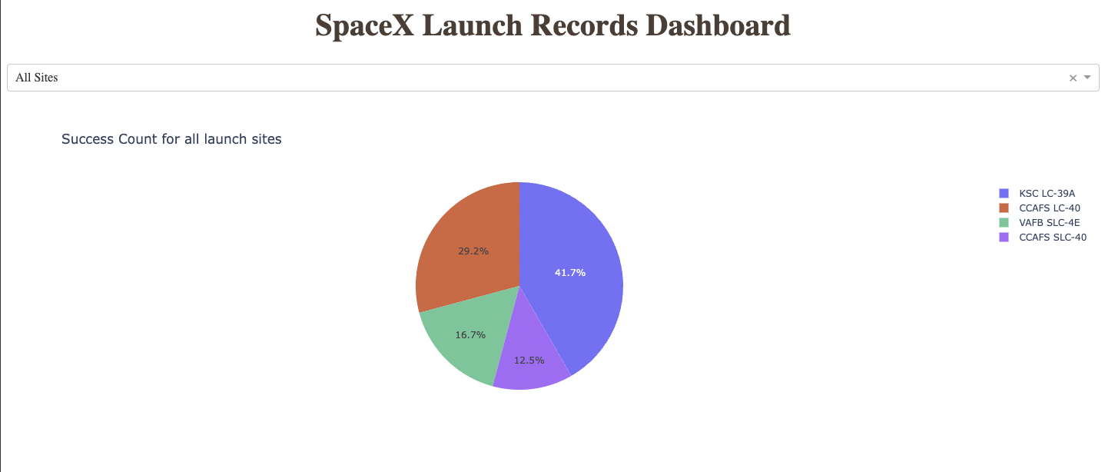
Launch success count for all sites
The above chart shows that KSC LC-39A is the most successful launch site.

Slide 40
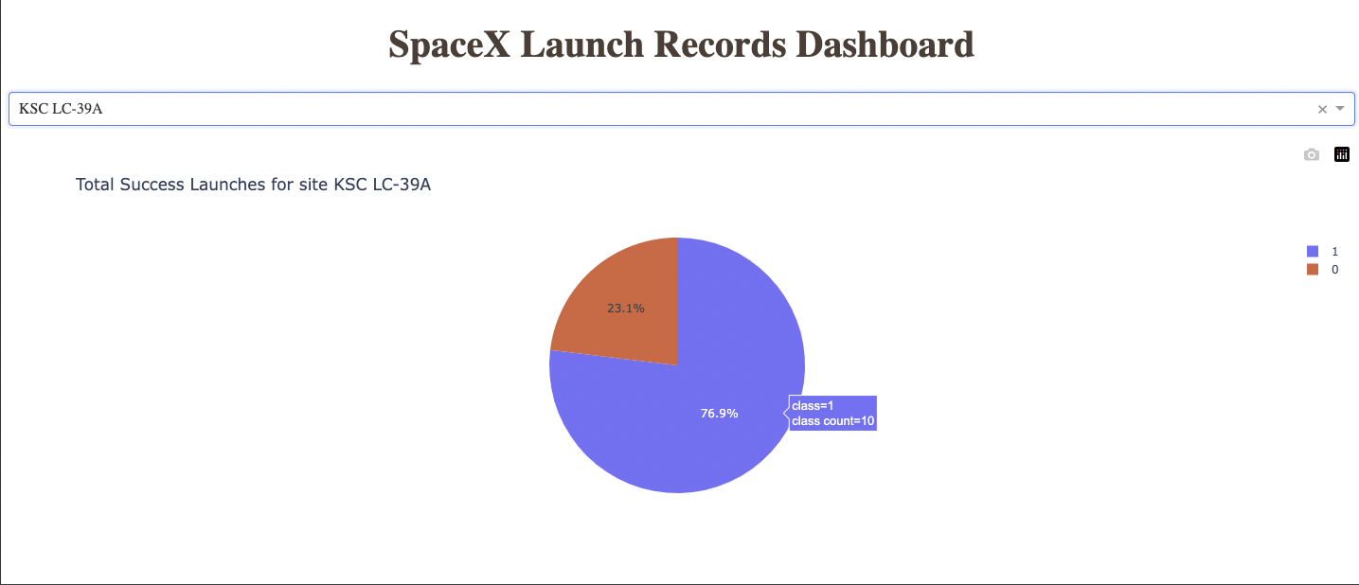
Launch site with highest launch success ratio
Site KSC LC-39A has the highest success ratio as shown above.

Slide 41
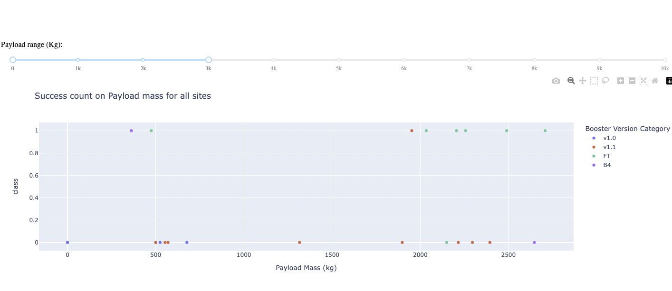
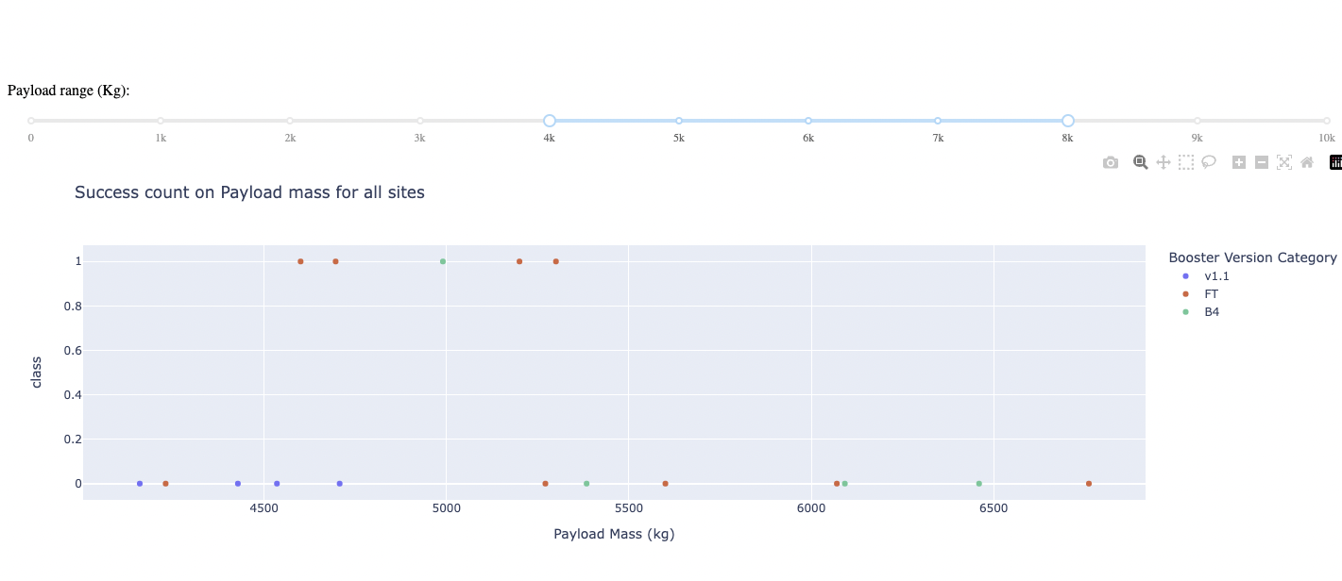
Payload vs. Launch Outcome scatter plot for all sites
As the above charts show, the heavier the payload the more chance of failure. We can say Payload and Launch Outcome are negatively correlated.

Slide 42

Section 5

Slide 43
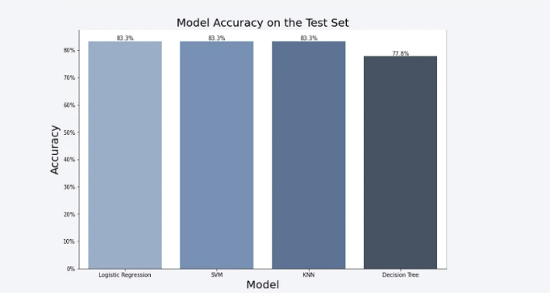
Classification Accuracy

Slide 44
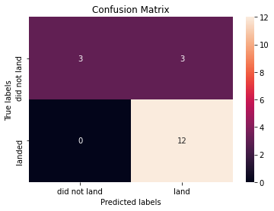
Confusion Matrix
All 3 Models provided the same accuracy.

Slide 45
Conclusions
Point 1 – All 4 showed equal amounts of accuracy.
Point 2 – The lower the payload, the more chance of a successful outcome.
Point 3 – As the years have passed, the success rate of SpaceX has increased.
Point 4 – KSC LC 39A is the most successful launch site.

Slide 46


